Slide 1


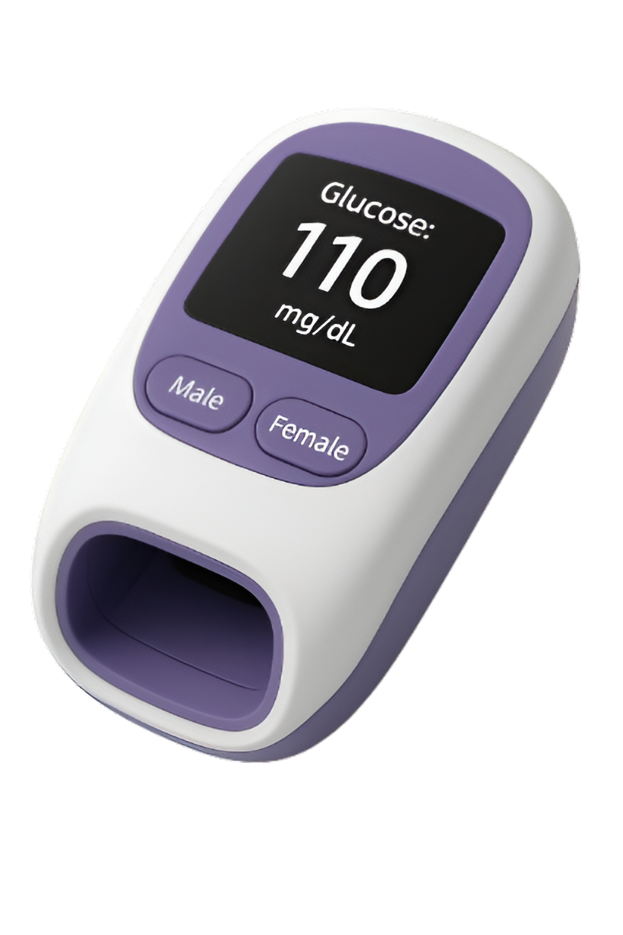


NON-INVASIVE GLUCOMETER
TEAM MEMBERS:
VISHWESHWARA (23BM061)
VARSHINI S (23BM057)
VISHNU G (23BM060)
INDHUJA B (23BM018)

Slide 2

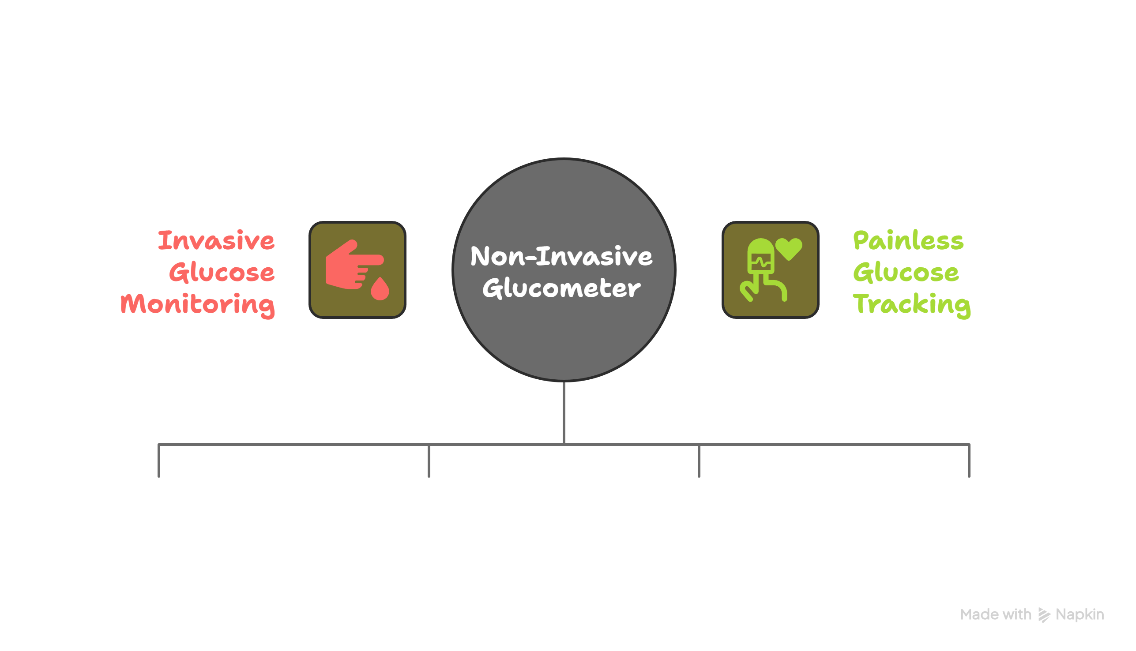
Elevator Pitch
Non-Invasive Glucose Monitoring
Millions of people with diabetes rely on invasive finger-prick glucometers, causing discomfort, infection risk, and poor adherence.
A portable, non-invasive glucometer that uses near-infrared light (950 nm) and a photodetector to estimate glucose levels through the skin, reducing pain and improving compliance.
Target Users
Individuals with Type 1 & Type 2 diabetes
Elderly patients and children requiring painless solutions
Fig 1 : Pitch Overview
Clinics, hospitals, and remote healthcare setups
Wellness-conscious individuals seeking preventive tracking
NON-INVASIVE GLUCOMETER

Slide 3












Non-Invasive Glucometer: Technology and Features
NIR Spectroscopy
Non-Invasive Glucometer
950 nm Light
Glucose Absorption
User Features
Connectivity
Pain-Free and Blood-Free
Bluetooth / WiFi Module
Portable or Wearable Design
Syncs with Mobile App
Rechargeable Battery
Advantages
Measurement Process
No Finger Pricking
Light Passes Through Skin
Real-Time Monitoring
Glucose Absorbs Wavelengths
No Test Strips Required
Reflected Signal Analyzed
Fig 2 : Idea Brainstorming
NON-INVASIVE GLUCOMETER

Slide 4
Problem Solutions fit
Problem
Solutions
Current glucometers require finger pricking, which causes discomfort, pain, and risk of infection.
Developing a non-invasive glucometer using 950 nm infrared light and photodetectors, similar to pulse oximeter technology.
People in rural/remote areas often lack access to easy and affordable monitoring.
Build a portable, cost-effective finger-clip device with digital display for immediate glucose readings.
Current devices don't provide continuous, non-invasive glucose tracking.
Potential for continuous and painless glucose monitoring, improving patient compliance and health outcomes.
NON-INVASIVE GLUCOMETER

Slide 5
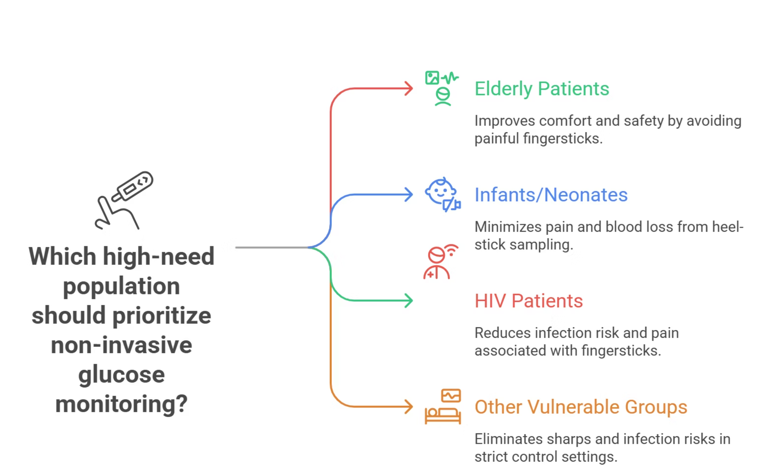
Market Opportunity
Fig 3 : Market Opportunity
NON-INVASIVE GLUCOMETER

Slide 6
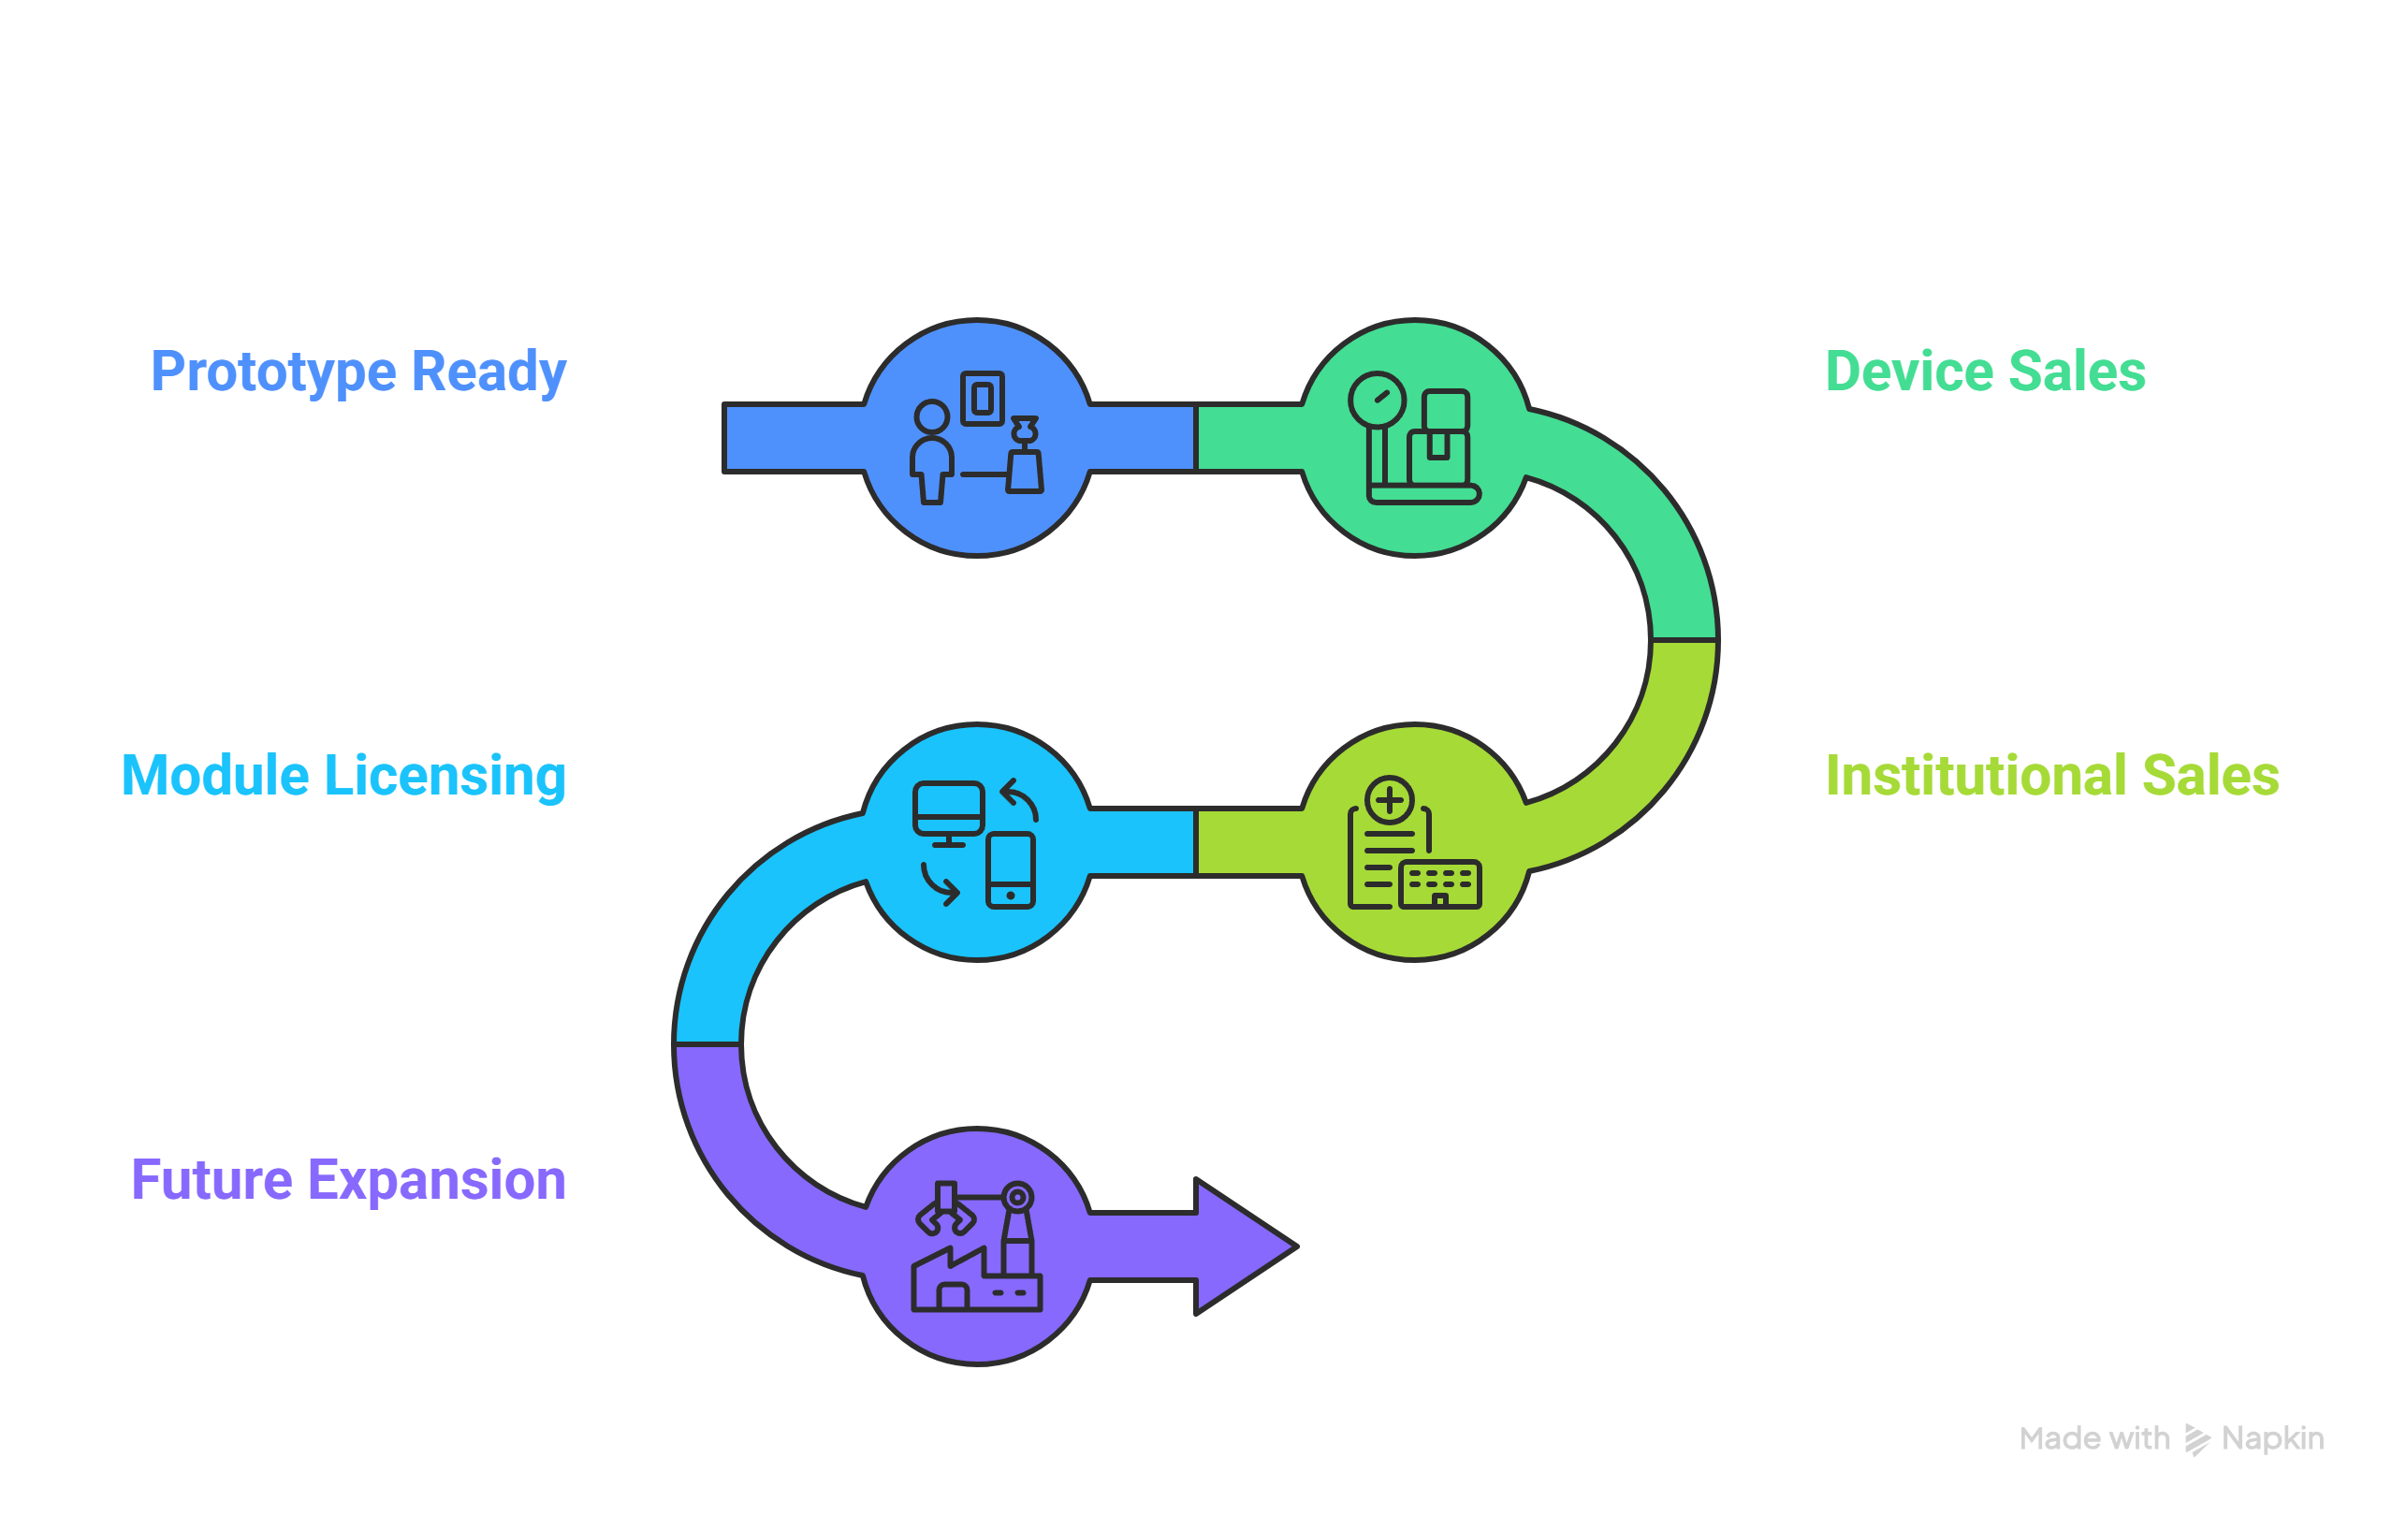
Monetization
1. Device Sales
Strategic Monetization and Expansion Timeline
One-time sale of the non-invasive glucometer
Target pricing: ₹1200–₹1500 (low-cost, reusable)
Affordable compared to conventional meters (which require regular test strips)
2. Institutional Partnerships
Bulk orders for hospitals, clinics, diagnostics labs, rural PHCs
Targeted outreach through CSR and public health programs.
3. Component-Level Sales / Licensing
Offer the sensor module as a plug-and-play unit for integration into third-party health devices
Licensing opportunities for med-tech companies or research institutes
4. Future Expansion
Fig 4 : Monetization Strategy
Industrial-scale manufacturing for cost reduction
Extended applications: hydration monitoring, hemoglobin tracking, etc.
NON-INVASIVE GLUCOMETER

Slide 7
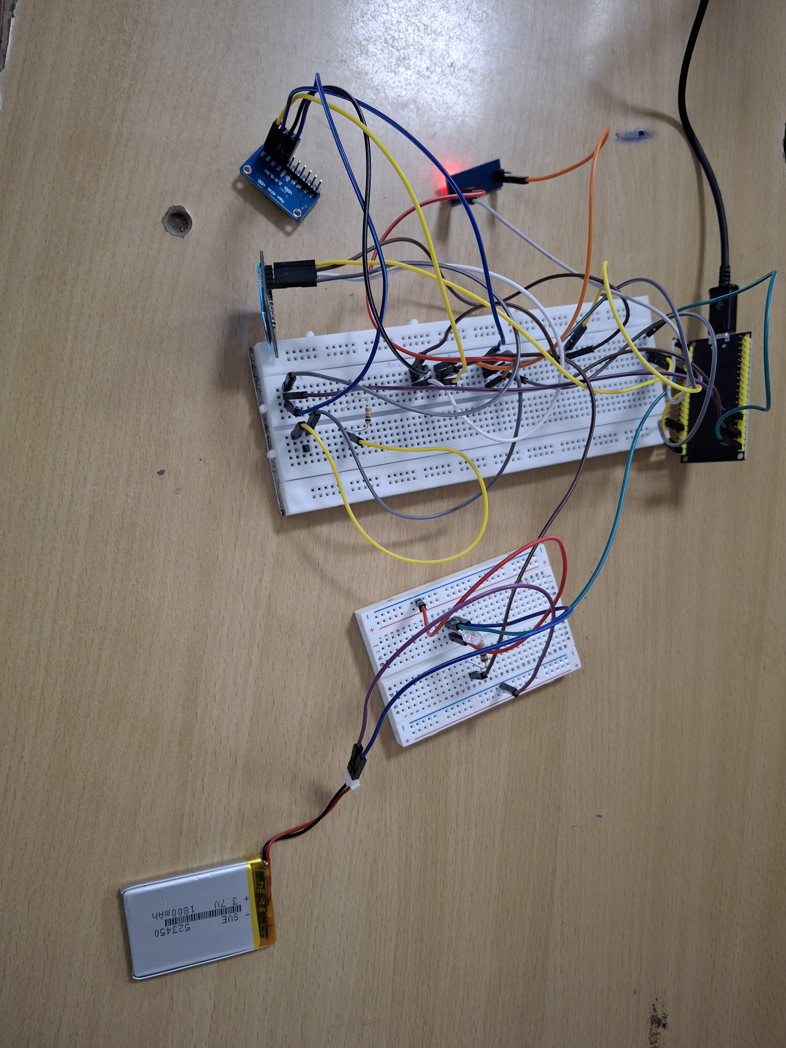
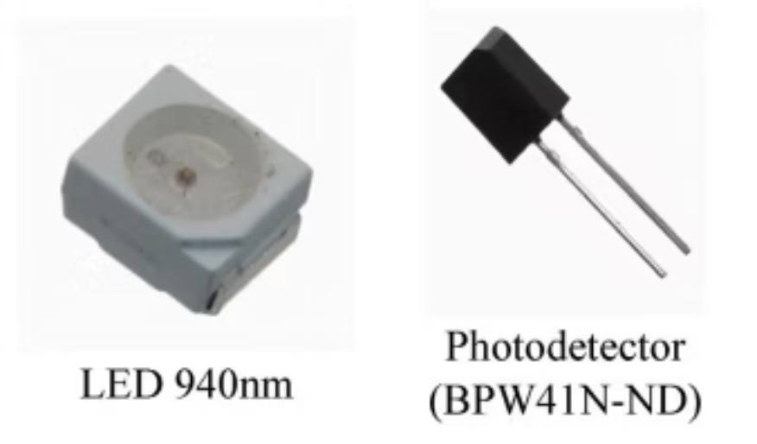
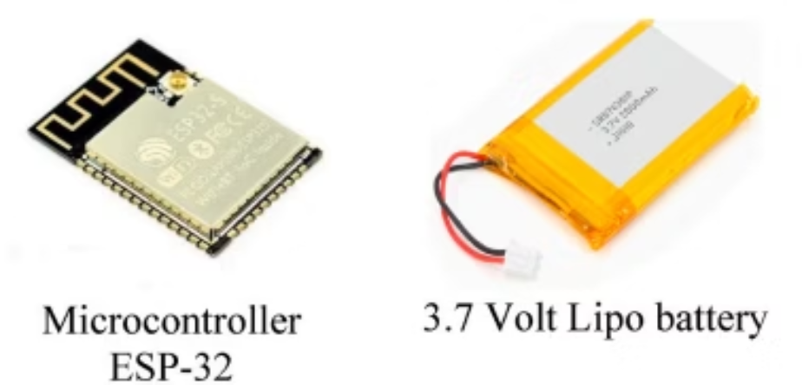
Appendix
LED 940nm Photodetector (BPW41N-ND)
Fig. 6. Designed system.
Microcontroller ESP-32 3.7 Volt Lipo battery
NON-INVASIVE GLUCOMETER

Slide 8
Thank You
NON-INVASIVE GLUCOMETER

